Slide 1
DBSCAN.
Clustering by unmasking.
Hierarchical Clustering.
Radu Ionescu, Prof. PhD.
raducu.ionescu@gmail.com
Faculty of Mathematics and Computer Science
University of Bucharest

Slide 2
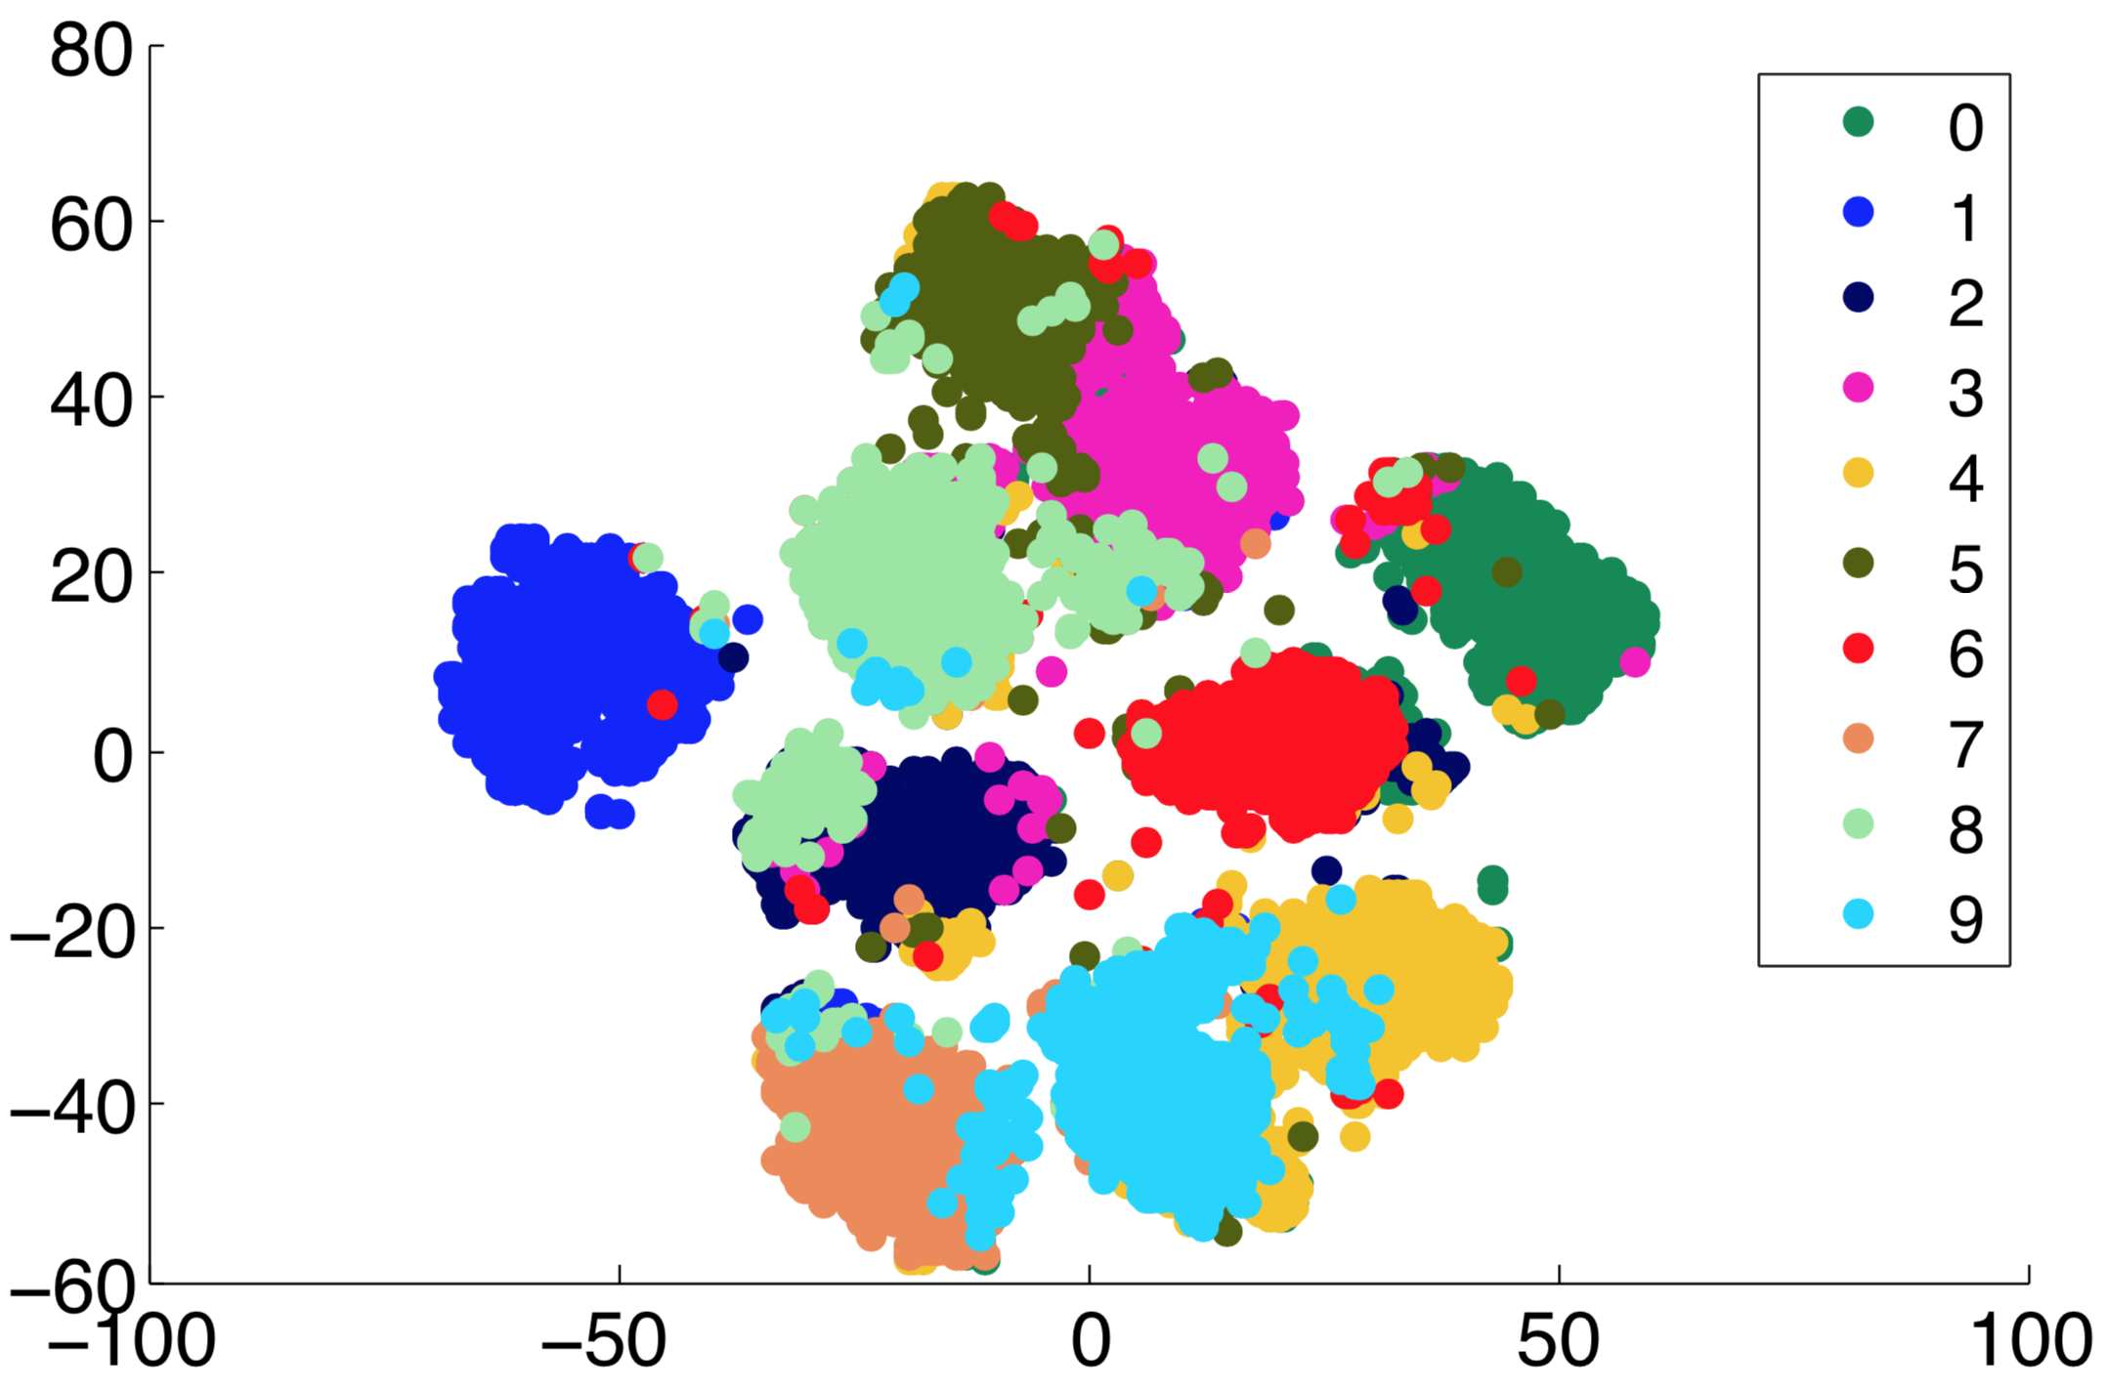
Reminder: Unsupervised Learning
There are no labels for the training phase
Our goal is to discover structure in data

Slide 3
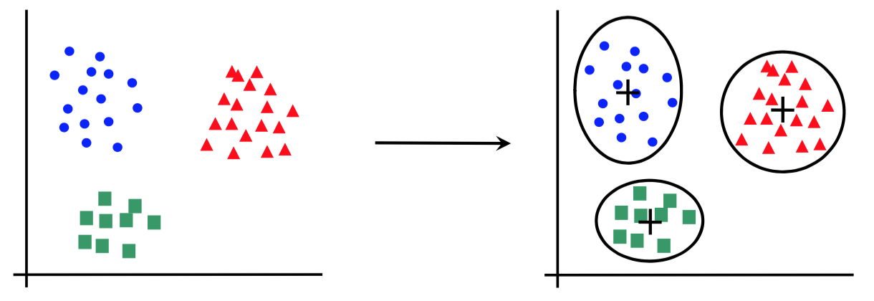
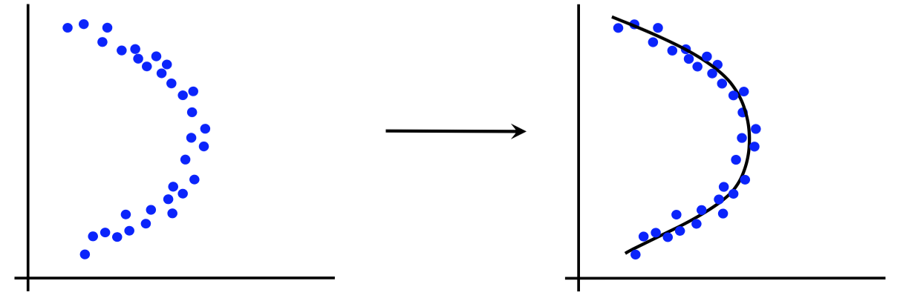
Canonical forms of unsupervised learning problems
Clustering
Dimensionality Reduction
K-means
DBSCAN
Hierarchical Clustering
…
Principal Component Analysis
t-SNE
…

Slide 4
DBSCAN

Slide 5
DBSCAN
DBSCAN stands for Density-based Spatial Clustering of Applications with Noise
DBSCAN is data clustering algorithm that groups points which are closely packed together in feature space
It was introduced in 1996:
Martin Ester, Hans-Peter Kriegel, Jörg Sander, Xiaowei Xu. A density-based algorithm for discovering clusters in large spatial databases with noise. Proceedings of KDD, pp. 226–231, 1996
Unlike k-means, it does not require the number of clusters to be known in advance
It has other hyperparameters that define the density of the formed clusters

Slide 6
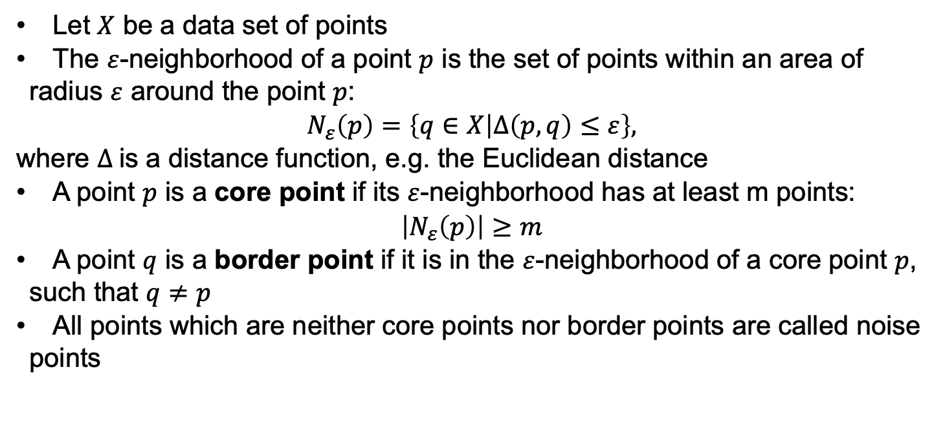
Terminology
Let $X$ be a data set of points
The $ε$-neighborhood of a point $p$ is the set of points within an area of radius $ε$ around the point $p$:
$$N_{ε}\left(p\right)=\left\{q∈X | Δ\left(p,q\right)≤ε\right\},$$
where $Δ$is a distance function, e.g. the Euclidean distance
A point $p$ is a core point if its $ε$-neighborhood has at least m points:
$$\left|N_{ε}\left(p\right)\right|≥m$$
A point $q$ is a border point if it is in the $ε$-neighborhood of a core point $p$, such that $q≠p$
All points which are neither core points nor border points are called noise points

Slide 7









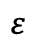
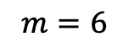
Terminology
$$m=6$$
$$ε$$

Slide 8
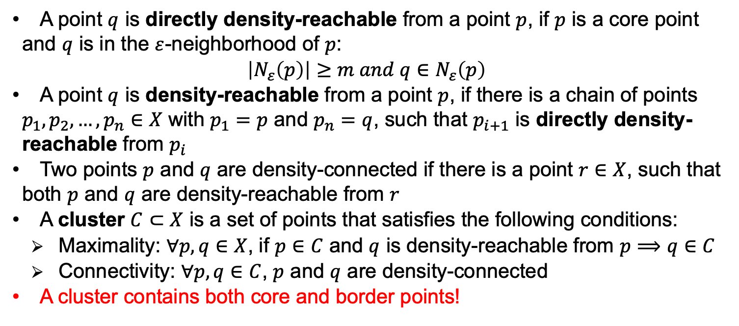
Terminology
A point $q$ is directly density-reachable from a point $p$, if $p$ is a core point and $q$ is in the $ε$-neighborhood of $p$:
$$\left|N_{ε}\left(p\right)\right|≥m and q∈N_{ε}\left(p\right)$$
A point $q$ is density-reachable from a point $p$, if there is a chain of points $p_{1},p_{2},…,p_{n}∈X$ with $p_{1}=p$ and $p_{n}=q$, such that $p_{i+1}$ is directly density-reachable from $p_{i}$
Two points $p$ and $q$ are density-connected if there is a point $r∈X$, such that both $p$ and $q$ are density-reachable from $r$
A cluster $C⊂X$ is a set of points that satisfies the following conditions:
Maximality: $∀p,q∈X$, if $p∈C$ and $q$ is density-reachable from $p⟹q∈C$
Connectivity: $∀p,q∈C$, $p$ and $q$ are density-connected
A cluster contains both core and border points!

Slide 9

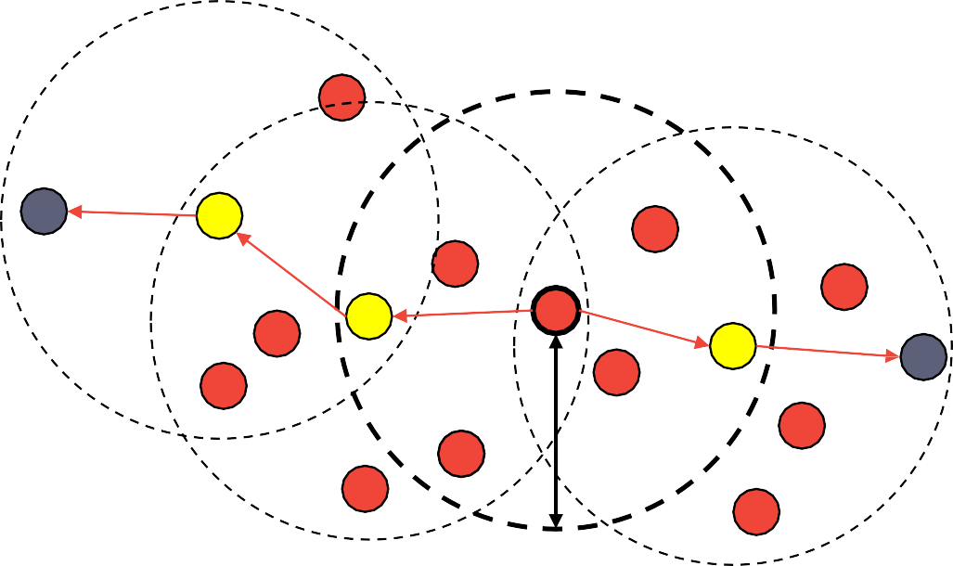



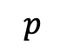
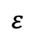
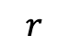
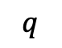
Terminology
$$m=6$$
$$p$$
$$r$$
$$q$$
$$ε$$
$p$ and $q$ are density-connected

Slide 10











Terminology
$$m=6$$
$$ε$$

Slide 11

Terminology
$$m=6$$

Slide 12
DBSCAN Algorithm (Python)
current_id = 1
for p in X:
C[p] = -1 # initialize clustering assignments
for p in X:
if is_core_point(p) == True:
C[p] = current_id # label p with a unique cluster ID
for q in X:
if is_density_reachable(p,q) and p is not q:
C[q] = current_id # label q with the same cluster ID as p
current_id += 1
else if C[p] == -1: # p has no label
C[p] = 0 # label p as noise for now (might get relabeled later)

Slide 13
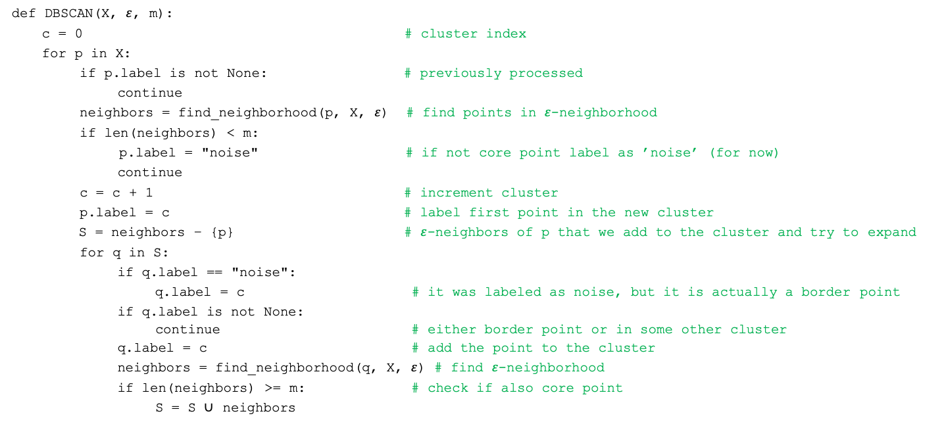
DBSCAN Algorithm in more details (Python)
def DBSCAN(X, $ε$, m):
c = 0 # cluster index
for p in X:
if p.label is not None: # previously processed
continue
neighbors = find_neighborhood(p, X, $ε$) # find points in $ε$-neighborhood
if len(neighbors) < m:
p.label = "noise" # if not core point label as ’noise’ (for now)
continue
c = c + 1 # increment cluster
p.label = c # label first point in the new cluster
S = neighbors – {p} # $ε$-neighbors of p that we add to the cluster and try to expand
for q in S:
if q.label == "noise":
q.label = c # it was labeled as noise, but it is actually a border point
if q.label is not None:
continue # either border point or in some other cluster
q.label = c # add the point to the cluster
neighbors = find_neighborhood(q, X, $ε$) # find $ε$-neighborhood
if len(neighbors) >= m: # check if also core point
S = S ∪ neighbors

Slide 14
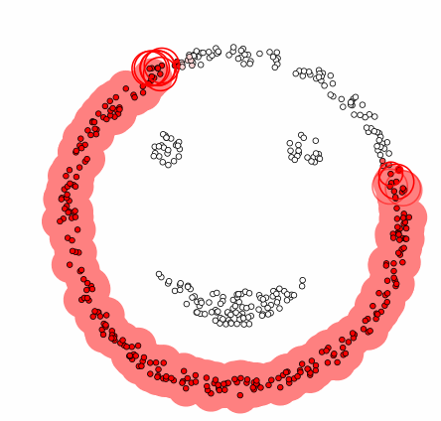
DBSCAN Algorithm

Slide 15
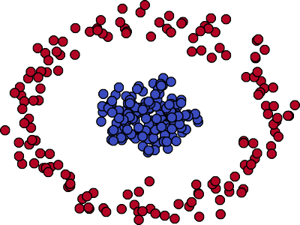
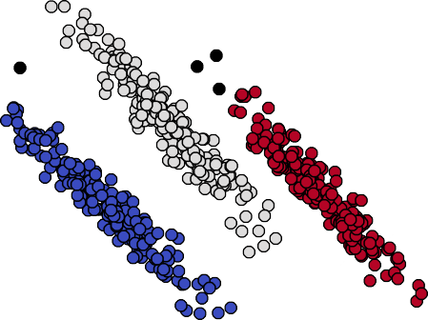
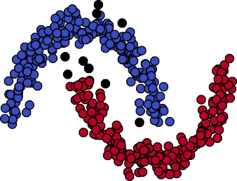
DBSCAN results
DBSCAN can handle non-convex clusters of various shapes
It does not require the number of clusters to be given as input
The distance metric can also be considered as a hyperparameter
Euclidean distance is the most commonly used

Slide 16
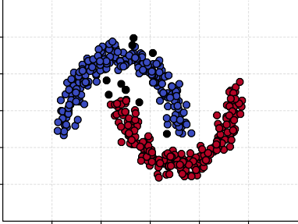
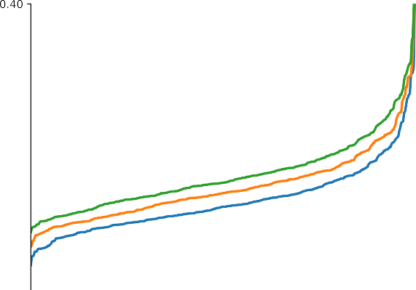
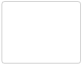
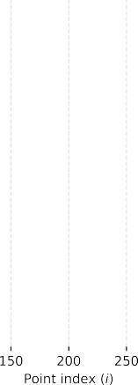
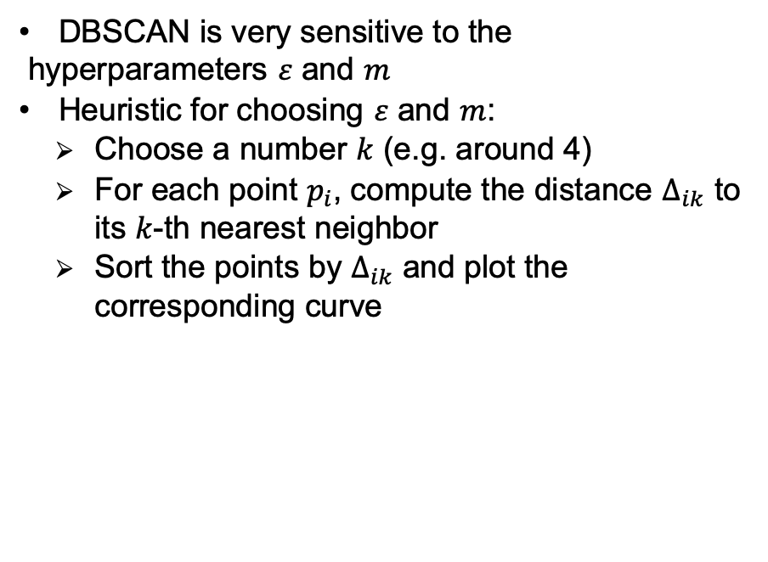
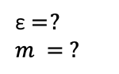
Hyperparameter tuning
DBSCAN is very sensitive to the hyperparameters $ε$ and $m$
Heuristic for choosing $ε$ and $m$:
Choose a number $k$ (e.g. around 4)
For each point $p_{i}$, compute the distance $Δ_{ik}$ to its $k$-th nearest neighbor
Sort the points by $Δ_{ik}$ and plot the corresponding curve
ε = ?
$$m = ?$$

Slide 17
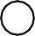
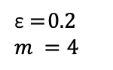
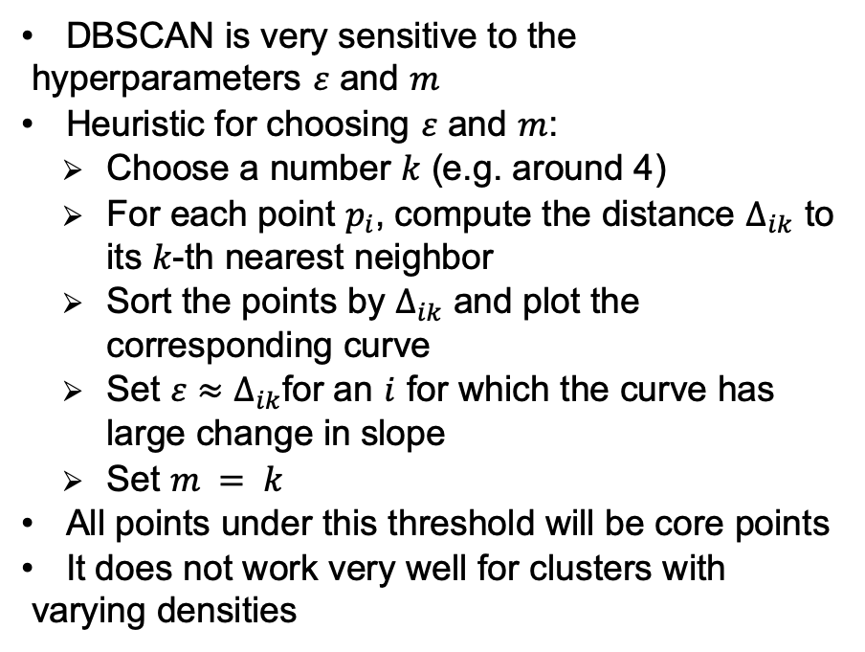
Hyperparameter tuning
DBSCAN is very sensitive to the hyperparameters $ε$ and $m$
Heuristic for choosing $ε$ and $m$:
Choose a number $k$ (e.g. around 4)
For each point $p_{i}$, compute the distance $Δ_{ik}$ to its $k$-th nearest neighbor
Sort the points by $Δ_{ik}$ and plot the corresponding curve
Set $ε≈Δ_{ik}$for an $i$ for which the curve has large change in slope
Set $m = k$
All points under this threshold will be core points
It does not work very well for clusters with varying densities
ε = 0.2
$$m =4$$

Slide 18
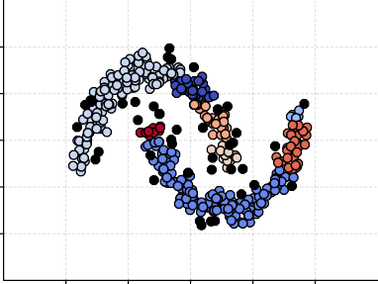

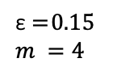
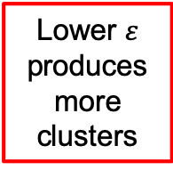
Hyperparameter tuning
DBSCAN is very sensitive to the hyperparameters $ε$ and $m$
Heuristic for choosing $ε$ and $m$:
Choose a number $k$ (e.g. around 4)
For each point $p_{i}$, compute the distance $Δ_{ik}$ to its $k$-th nearest neighbor
Sort the points by $Δ_{ik}$ and plot the corresponding curve
Set $ε≈Δ_{ik}$for an $i$ for which the curve has large change in slope
Set $m = k$
All points under this threshold will be core points
It does not work very well for clusters with varying densities
ε = 0.15
$$m =4$$
Lower $ε$ produces more clusters

Slide 19
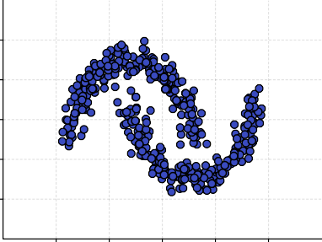

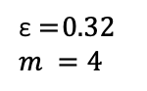
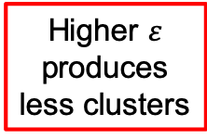
Hyperparameter tuning
DBSCAN is very sensitive to the hyperparameters $ε$ and $m$
Heuristic for choosing $ε$ and $m$:
Choose a number $k$ (e.g. around 4)
For each point $p_{i}$, compute the distance $Δ_{ik}$ to its $k$-th nearest neighbor
Sort the points by $Δ_{ik}$ and plot the corresponding curve
Set $ε≈Δ_{ik}$for an $i$ for which the curve has large change in slope
Set $m = k$
All points under this threshold will be core points
It does not work very well for clusters with varying densities
ε = 0.32
$$m =4$$
Higher $ε$ produces less clusters

Slide 20
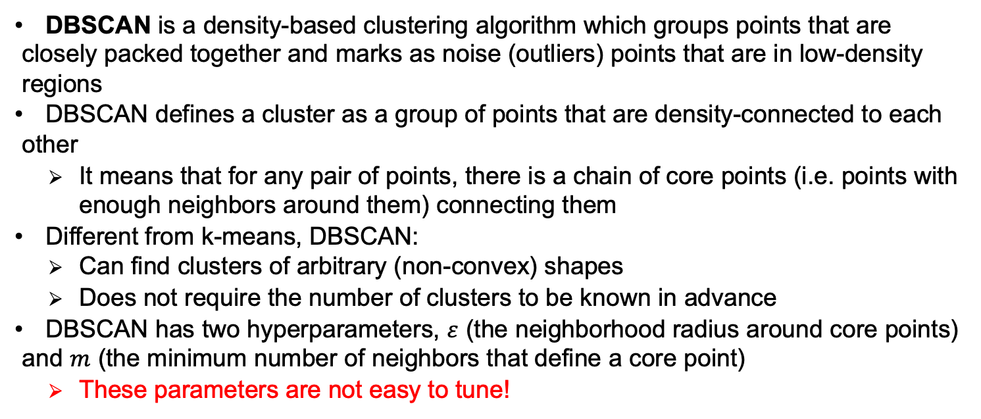
Summary
DBSCAN is a density-based clustering algorithm which groups points that are closely packed together and marks as noise (outliers) points that are in low-density regions
DBSCAN defines a cluster as a group of points that are density-connected to each other
It means that for any pair of points, there is a chain of core points (i.e. points with enough neighbors around them) connecting them
Different from k-means, DBSCAN:
Can find clusters of arbitrary (non-convex) shapes
Does not require the number of clusters to be known in advance
DBSCAN has two hyperparameters, $ε$ (the neighborhood radius around core points) and $m$ (the minimum number of neighbors that define a core point)
These parameters are not easy to tune!

Slide 21
Clustering by unmasking

Slide 22
Clustering by unmasking
Clustering by unmasking is a novel agglomerative clustering method based on unmasking
It was introduced in 2019:
Mariana-Iuliana Georgescu, Radu Tudor Ionescu. Clustering Images by Unmasking – A New Baseline. Proceedings of ICIP, pp. 1580–1584, 2019.
Unmasking is a technique that was previously used for authorship verification of text documents:
Moshe Koppel, Jonathan Schler, Elisheva Bonchek-Dokow. Measuring Differentiability: Unmasking Pseudonymous Authors. Journal of Machine Learning Research, 8:1261–1276, 2007.

Slide 23

Unmasking for authorship verification
John
Luke
Mark
Matthew
?

Slide 24
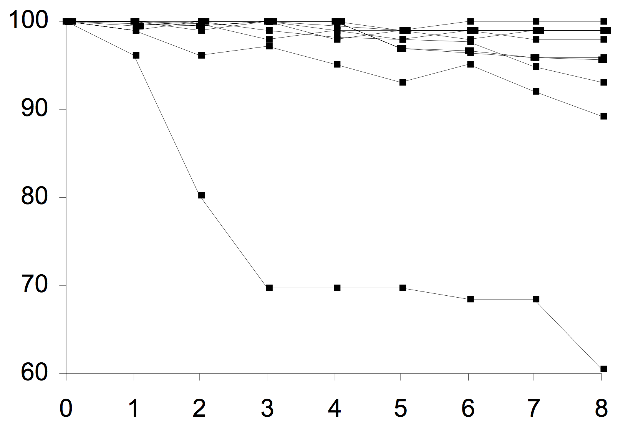
Unmasking for authorship verification
Unmasking [Koppel et al., JMLR07]: iteratively remove the best features useful for distinguishing between two documents to measure the degradation rate of the cross-validation accuracy
Accuracy
Mark
Notes:
Notes:
Let people figure things out
See if they agree or contradict

Slide 25
Unmasking for authorship verification
At first, a bit hard to think of, but consider this:
Accuracy stays high if objects are different to their core!
Matthew
John
Luke
Accuracy

Slide 26
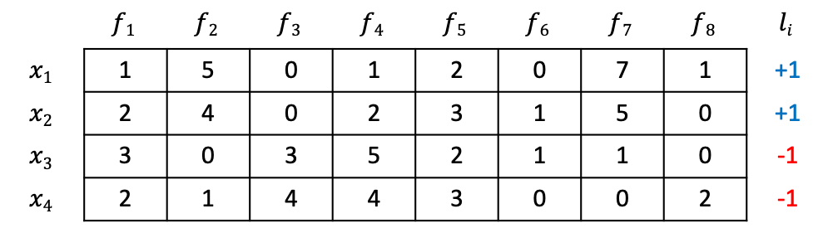
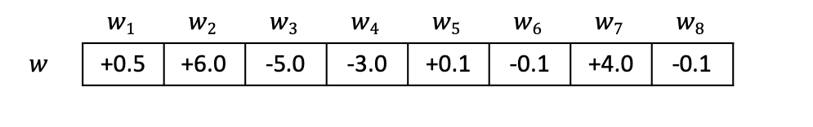
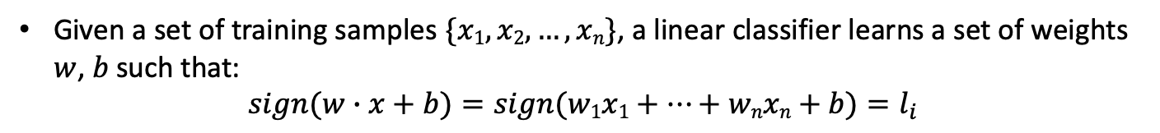
Unmasking – Loop 1.1.
 | $$f1$$ | $$f2$$ | $$f3$$ | $$f4$$ | $$f5$$ | $$f6$$ | $$f7$$ | $$f8$$ | $$li$$
$$x1$$ | 1 | 5 | 0 | 1 | 2 | 0 | 7 | 1 | +1
$$x2$$ | 2 | 4 | 0 | 2 | 3 | 1 | 5 | 0 | +1
$$x3$$ | 3 | 0 | 3 | 5 | 2 | 1 | 1 | 0 | -1
$$x4$$ | 2 | 1 | 4 | 4 | 3 | 0 | 0 | 2 | -1
Accuracy
 | $$w1$$ | $$w2$$ | $$w3$$ | $$w4$$ | $$w5$$ | $$w6$$ | $$w7$$ | $$w8$$
$$w$$ | +0.5 | +6.0 | -5.0 | -3.0 | +0.1 | -0.1 | +4.0 | -0.1
Iteration
Given a set of training samples $\{x1, x2, …, xn\}$, a linear classifier learns a set of weights $w$, $b$ such that:
$$sign(w∙x+b)=sign(w1x1+…+wnxn+b)=l_{i}$$
We evaluate the model and compute the accuracy
Notes:
Notes:
Mention unmaking, but do not explain it yet

Slide 27
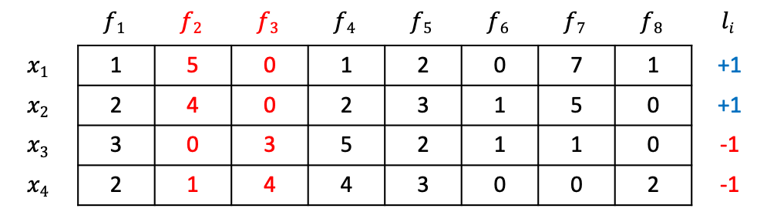
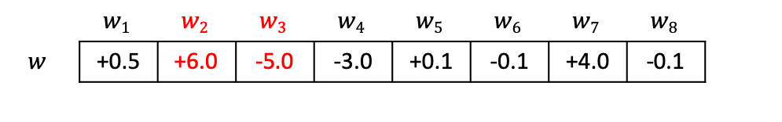
Unmasking – Loop 1.2.
 | $$f1$$ | $$f2$$ | $$f3$$ | $$f4$$ | $$f5$$ | $$f6$$ | $$f7$$ | $$f8$$ | $$li$$
$$x1$$ | 1 | 5 | 0 | 1 | 2 | 0 | 7 | 1 | +1
$$x2$$ | 2 | 4 | 0 | 2 | 3 | 1 | 5 | 0 | +1
$$x3$$ | 3 | 0 | 3 | 5 | 2 | 1 | 1 | 0 | -1
$$x4$$ | 2 | 1 | 4 | 4 | 3 | 0 | 0 | 2 | -1
Accuracy
 | $$w1$$ | $$w2$$ | $$w3$$ | $$w4$$ | $$w5$$ | $$w6$$ | $$w7$$ | $$w8$$
$$w$$ | +0.5 | +6.0 | -5.0 | -3.0 | +0.1 | -0.1 | +4.0 | -0.1
Iteration
We eliminate the features with the highest weights in absolute value
Notes:
Notes:
Mention unmaking, but do not explain it yet

Slide 28
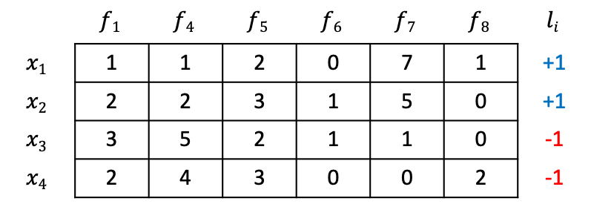
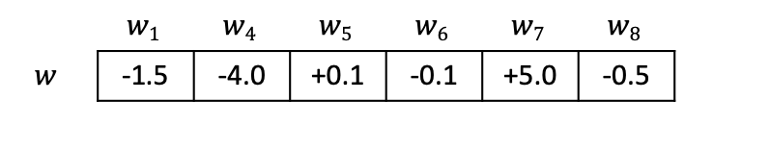
Unmasking – Loop 2.1.
 | $$f1$$ | $$f4$$ | $$f5$$ | $$f6$$ | $$f7$$ | $$f8$$ | $$li$$
$$x1$$ | 1 | 1 | 2 | 0 | 7 | 1 | +1
$$x2$$ | 2 | 2 | 3 | 1 | 5 | 0 | +1
$$x3$$ | 3 | 5 | 2 | 1 | 1 | 0 | -1
$$x4$$ | 2 | 4 | 3 | 0 | 0 | 2 | -1
Accuracy
 | $$w1$$ | $$w4$$ | $$w5$$ | $$w6$$ | $$w7$$ | $$w8$$
$$w$$ | -1.5 | -4.0 | +0.1 | -0.1 | +5.0 | -0.5
Iteration
Given a set of training samples $\{x1, x2, …, xn\}$, a linear classifier learns a set of weights $w$, $b$ such that:
$$sign(w∙x+b)=sign(w1x1+…+wnxn+b)=l_{i}$$
We evaluate the model and compute the accuracy
Notes:
Notes:
Mention unmaking, but do not explain it yet

Slide 29
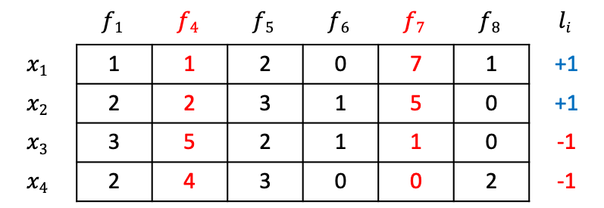
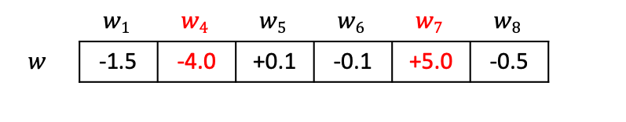
Unmasking – Loop 2.2.
 | $$f1$$ | $$f4$$ | $$f5$$ | $$f6$$ | $$f7$$ | $$f8$$ | $$li$$
$$x1$$ | 1 | 1 | 2 | 0 | 7 | 1 | +1
$$x2$$ | 2 | 2 | 3 | 1 | 5 | 0 | +1
$$x3$$ | 3 | 5 | 2 | 1 | 1 | 0 | -1
$$x4$$ | 2 | 4 | 3 | 0 | 0 | 2 | -1
Accuracy
 | $$w1$$ | $$w4$$ | $$w5$$ | $$w6$$ | $$w7$$ | $$w8$$
$$w$$ | -1.5 | -4.0 | +0.1 | -0.1 | +5.0 | -0.5
Iteration
We eliminate the features with the highest weights in absolute value
Notes:
Notes:
Mention unmaking, but do not explain it yet

Slide 30
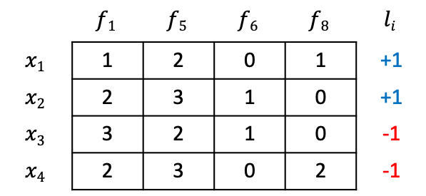
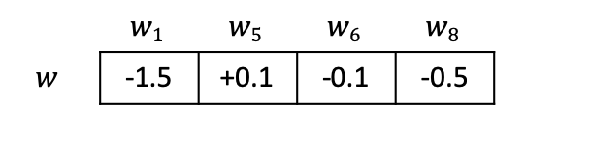
Unmasking – Loop 3.1.
 | $$f1$$ | $$f5$$ | $$f6$$ | $$f8$$ | $$li$$
$$x1$$ | 1 | 2 | 0 | 1 | +1
$$x2$$ | 2 | 3 | 1 | 0 | +1
$$x3$$ | 3 | 2 | 1 | 0 | -1
$$x4$$ | 2 | 3 | 0 | 2 | -1
Accuracy
 | $$w1$$ | $$w5$$ | $$w6$$ | $$w8$$
$$w$$ | -1.5 | +0.1 | -0.1 | -0.5
Iteration
And so on…
Notes:
Notes:
Mention unmaking, but do not explain it yet

Slide 31
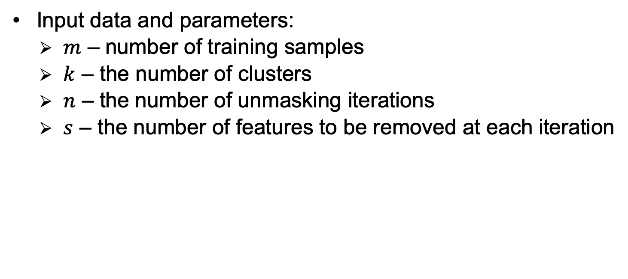
Clustering by unmasking (Algorithm)
Input data and parameters:
$m$ – number of training samples
$k$ – the number of clusters
$n$ – the number of unmasking iterations
$s$ – the number of features to be removed at each iteration

Slide 32
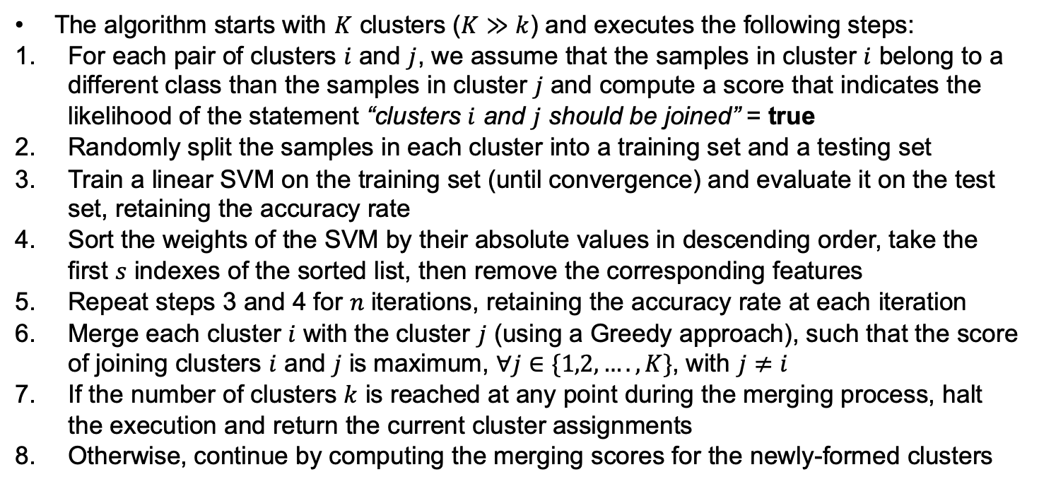
Clustering by unmasking (Algorithm)
The algorithm starts with $K$ clusters ($K≫k$) and executes the following steps:
For each pair of clusters $i$ and $j$, we assume that the samples in cluster $i$ belong to a different class than the samples in cluster $j$ and compute a score that indicates the likelihood of the statement “clusters $i$ and $j$ should be joined” = true
Randomly split the samples in each cluster into a training set and a testing set
Train a linear SVM on the training set (until convergence) and evaluate it on the test set, retaining the accuracy rate
Sort the weights of the SVM by their absolute values in descending order, take the first $s$ indexes of the sorted list, then remove the corresponding features
Repeat steps 3 and 4 for $n$ iterations, retaining the accuracy rate at each iteration
Merge each cluster $i$ with the cluster $j$ (using a Greedy approach), such that the score of joining clusters $i$ and $j$ is maximum, $∀j∈\{1,2,….,K\}$, with $j≠i$
If the number of clusters $k$ is reached at any point during the merging process, halt the execution and return the current cluster assignments
Otherwise, continue by computing the merging scores for the newly-formed clusters

Slide 33
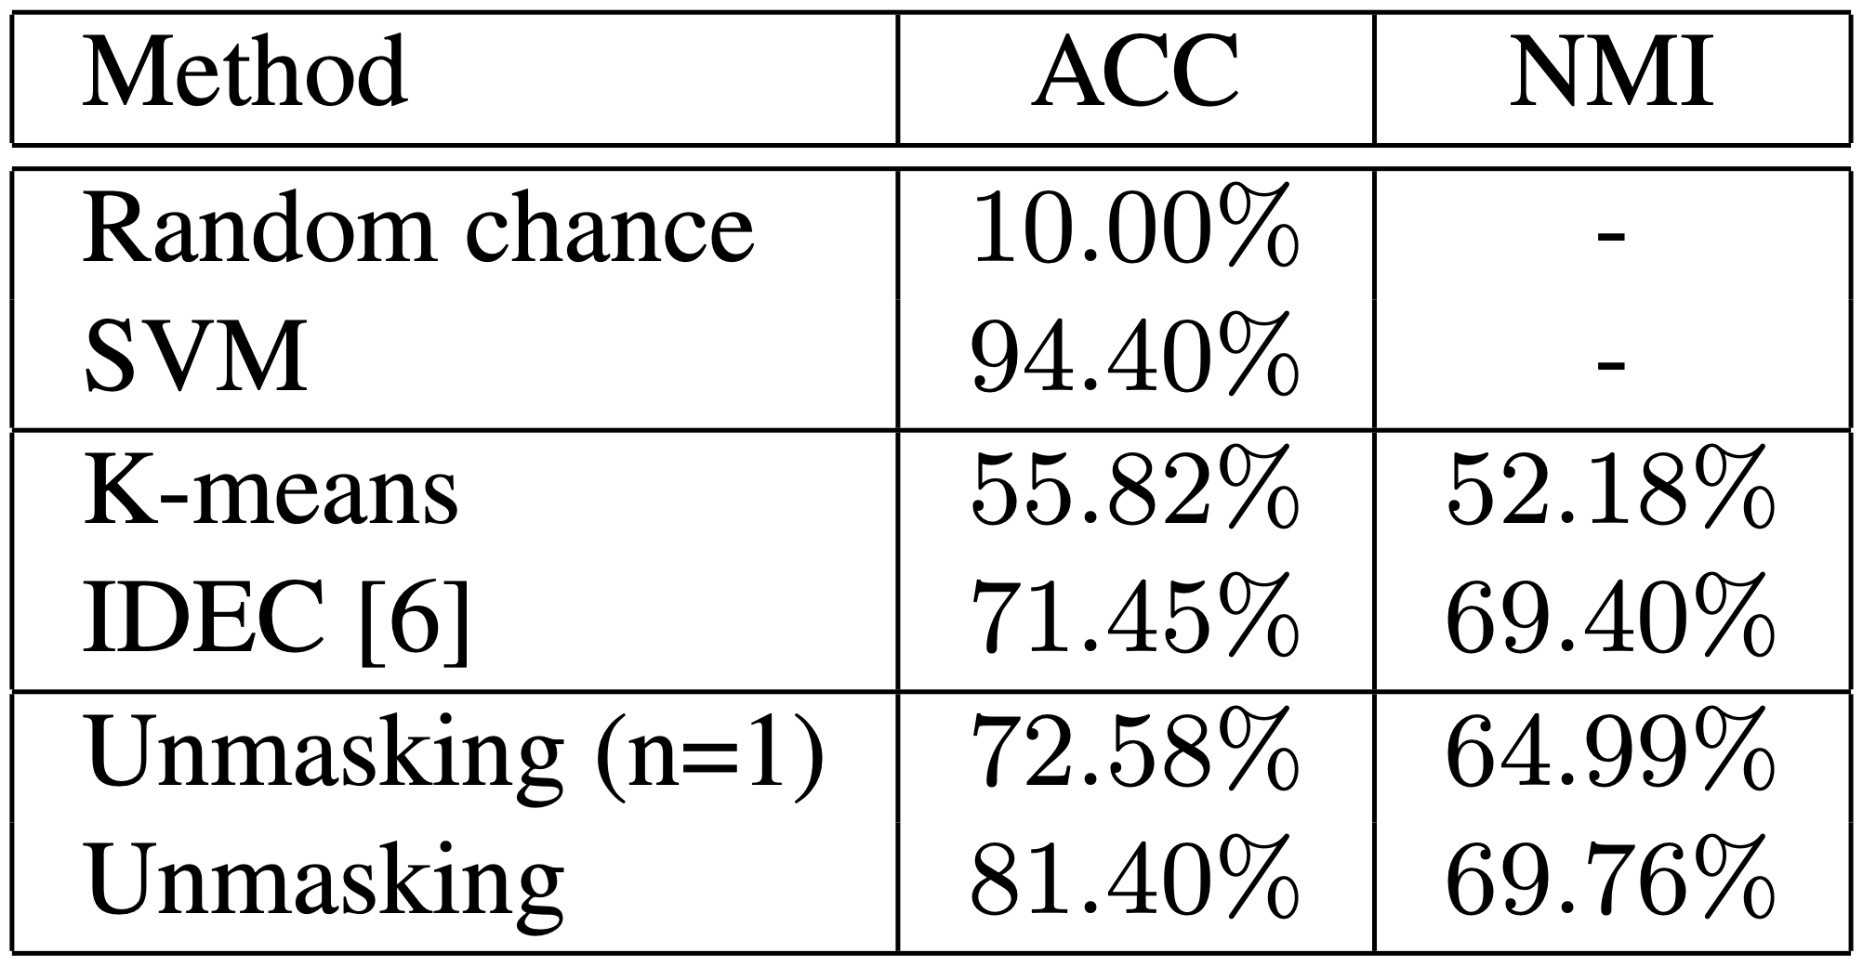
Results on MNIST

Slide 34
Results on MNIST

Slide 35
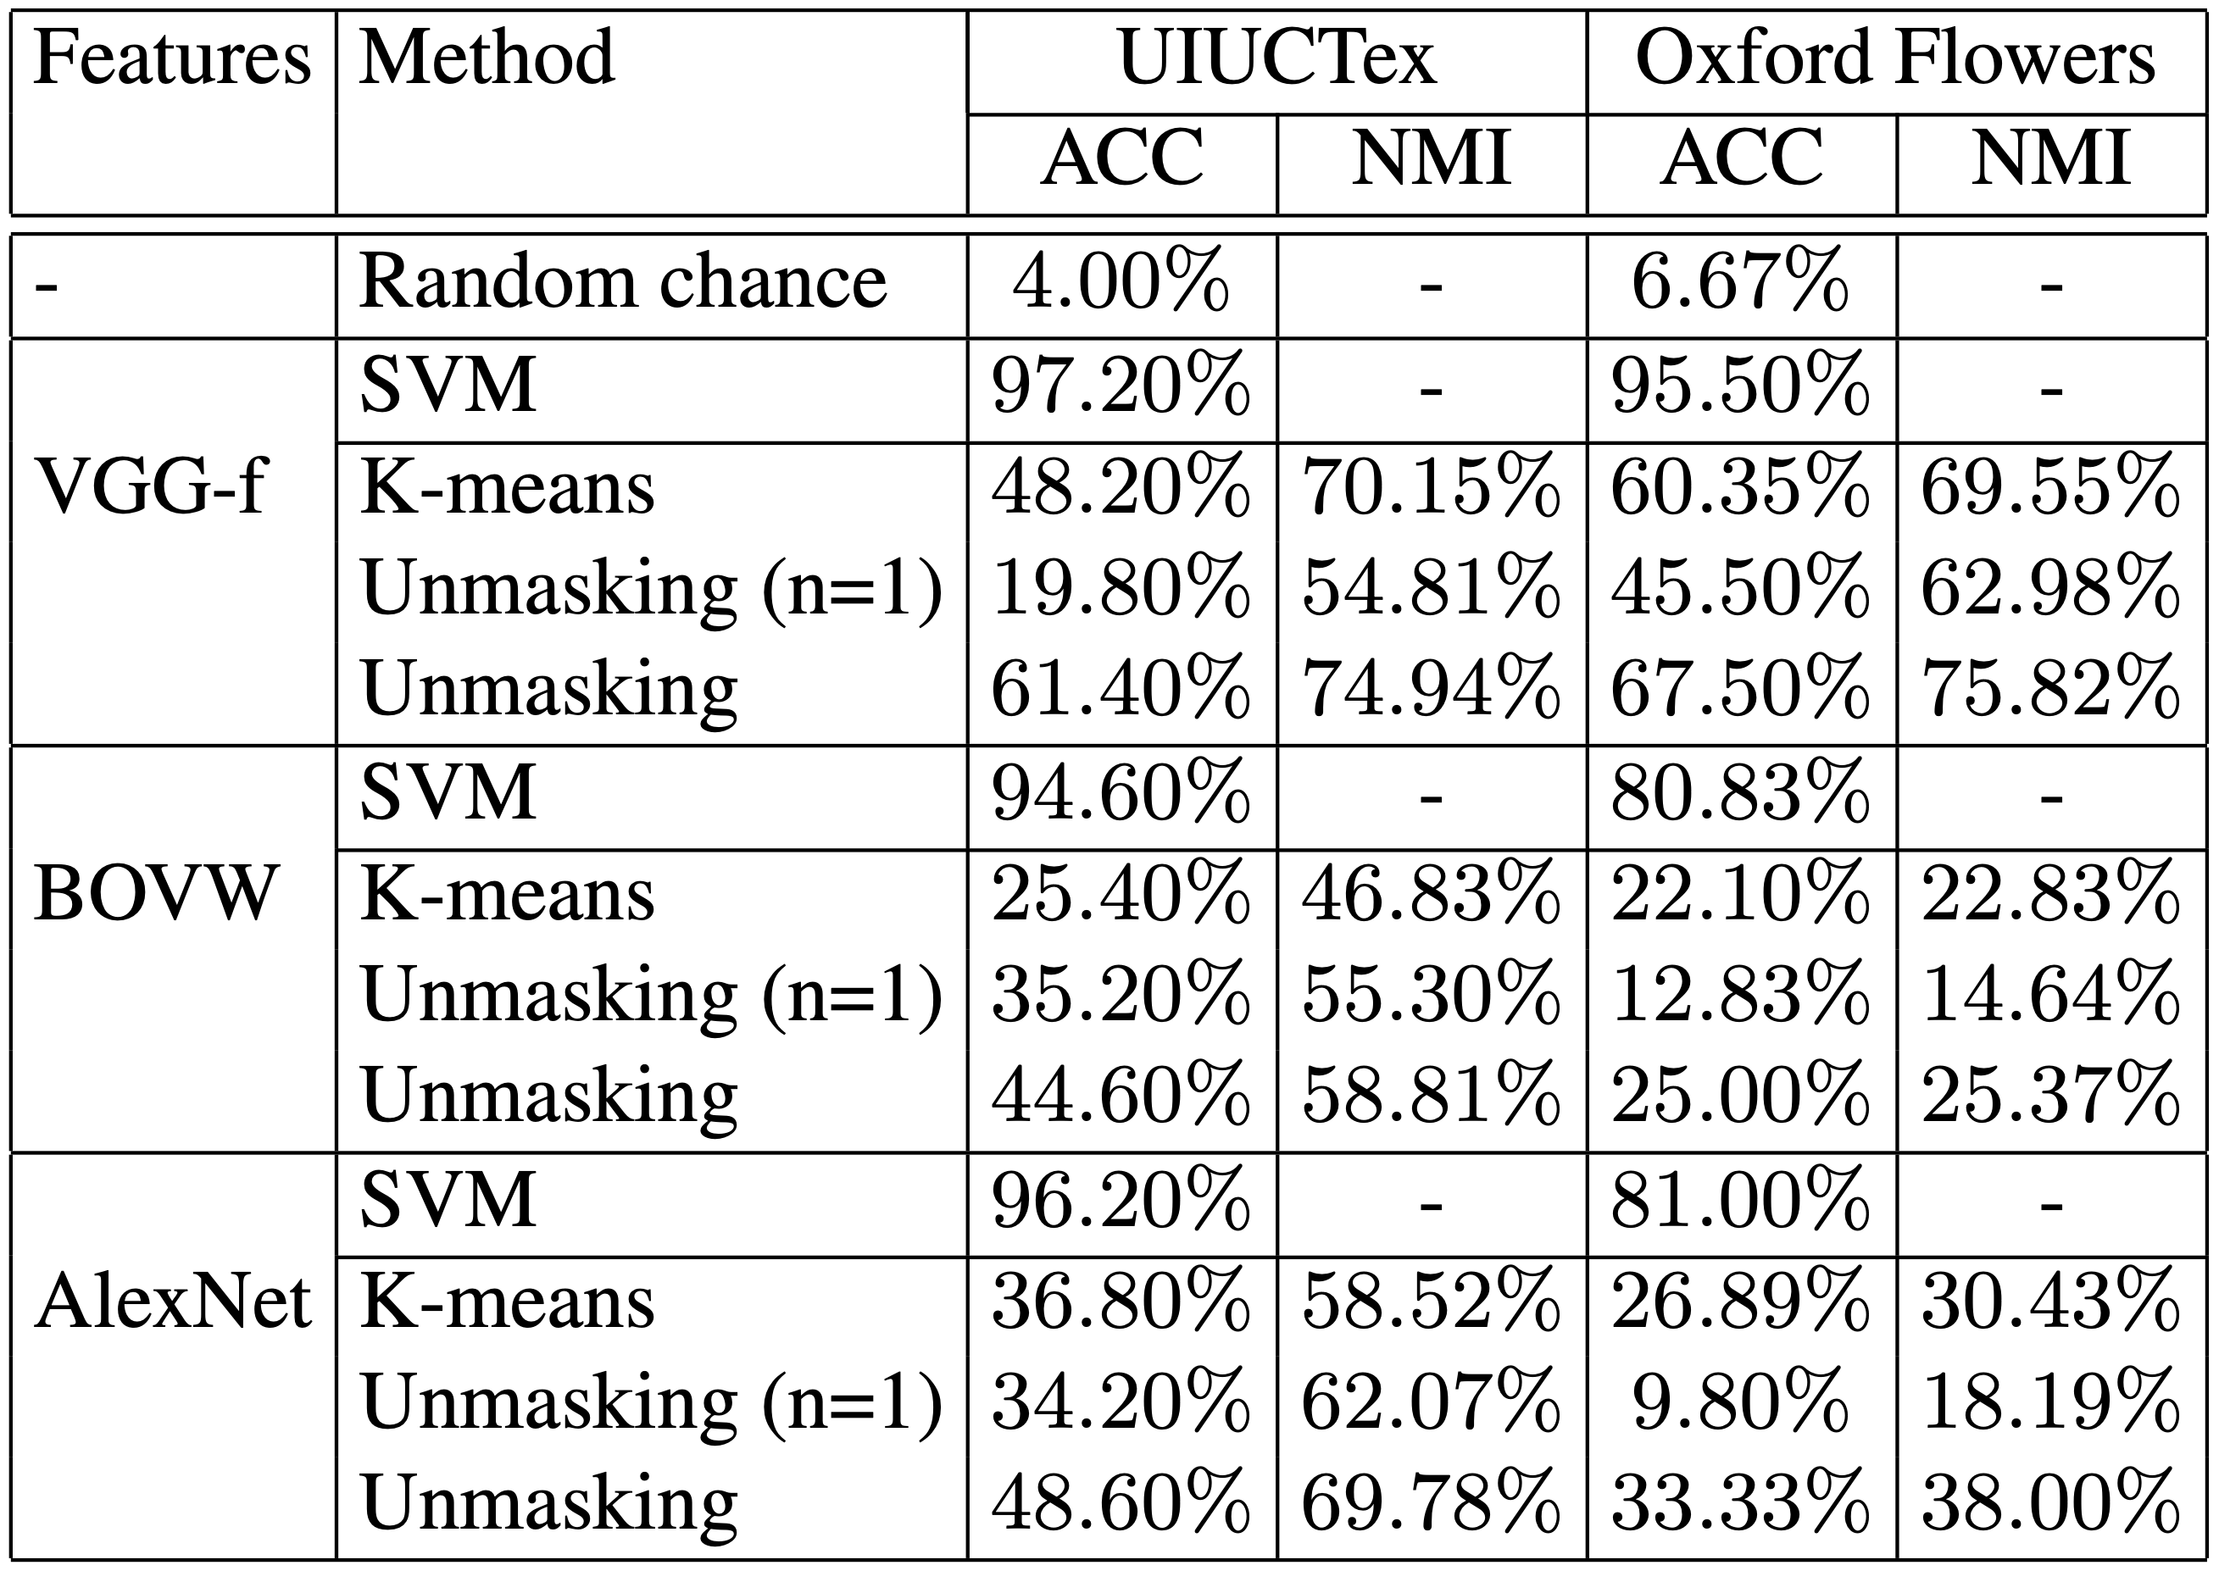
Results on UIUCTex and Oxford Flowers

Slide 36
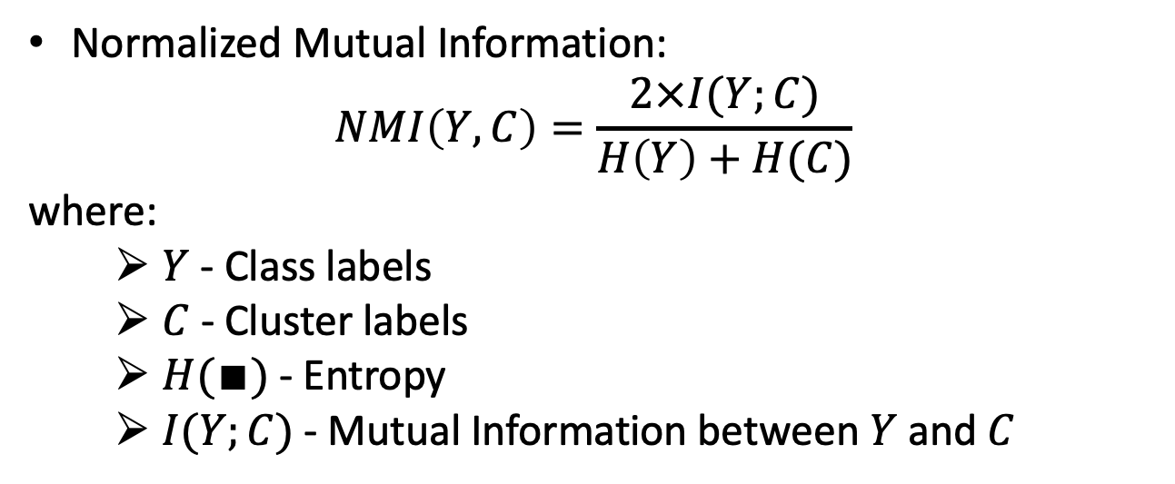
Normalized Mutual Information
Normalized Mutual Information:
$$NMI\left(Y,C\right)=\frac{2×I(Y;C)}{H\left(Y\right)+H(C)}$$
where:
$Y$ - Class labels
$C$ - Cluster labels
$H(∎)$ - Entropy
$I(Y;C)$ - Mutual Information between $Y$ and $C$

Slide 37





Calculating NMI for clustering
Assume $m=3$ classes and $k=2$ clusters:
Cluster 1 ($C=1$)
Cluster 2 ($C=2$)
Class 1 ($Y=1$)
Class 2 ($Y=2$)
Class 3 ($Y=3$)

Slide 38

$H(Y)$- Entropy of Class Labels
$P\left(Y=1\right)=\frac{5}{20}=\frac{1}{4}$
$H\left(Y\right)=−\frac{1}{4}log\frac{1}{4}−\frac{1}{4}log\frac{1}{4}$ $−\frac{1}{2}log\frac{1}{2}=1.5$
Notes:
This is calculated for the entire dataset and can be calculated prior to clustering, as it will not change depending on the clustering output.
All logs are base 2.

Slide 39

$H(Y)$- Entropy of Cluster Labels
$H\left(C\right)=−\frac{1}{2}log\frac{1}{2}$ $−\frac{1}{2}log\frac{1}{2}=1$
Notes:
This will be calculated every time the clustering changes.
You can see from the figure that the clusters are balanced (have equal number of instances).

Slide 40

I$(Y;C)$– Mutual Information
Mutual Information is given by:
$$I\left(Y;C\right)=H\left(Y\right)−H(Y|C)$$
Notes:
We already know $H(Y)$.
$H(Y|C)$is the entropy of class labels within each cluster.
Mutual Information tells us the reduction in the entropy of class labels that we get if we know the cluster labels (similar with Information Gain in decision trees).
How do we calculate $H(Y|C)$?

Slide 41


$H(Y|C)$– Conditional entropy of class labels for clustering C
For cluster 1:
P $\left(Y=3 \right| C=1)=\frac{4}{10}\text{(}\text{4 }\text{stars} \text{in} \text{cluster}\text{ 1)}$
The conditional entropy is:
$$H\left(Y | C=1\right)=−P(C=1)\sum_{y∈\{1,2,3\}}{P\left(Y=y | C=1\right) logP\left(Y=y | C=1\right)}$$
$$=−\frac{1}{2}\left(\frac{3}{10}log\frac{3}{10}+\frac{3}{10}log\frac{3}{10}+\frac{4}{10}log\frac{4}{10}\right)=0.7855$$

Slide 42

$H(Y|C)$– Conditional entropy of class labels for clustering C
For cluster 2:
P $\left(Y=3 \right| C=2)=\frac{1}{10}\text{(}\text{1 }\text{star} \text{in} \text{cluster}\text{ 2)}$
The conditional entropy is:
$$H\left(Y | C=2\right)=−P(C=2)\sum_{y∈\{1,2,3\}}{P\left(Y=y | C=2\right) logP\left(Y=y | C=2\right)}$$
$$=−\frac{1}{2}\left(\frac{2}{10}log\frac{2}{10}+\frac{7}{10}log\frac{7}{10}+\frac{1}{10}log\frac{1}{10}\right)=0.5784$$

Slide 43

Normalized Mutual Information
Finally, the mutual information is:
$$I\left(Y;C\right)=H\left(Y\right)−H(Y|C)$$
$$=1.5−\left(0.7855+0.5784\right)$$
$$=0.1361$$
Therefore, the NMI is:
$$NMI\left(Y,C\right)=\frac{2×I(Y;C)}{H\left(Y\right)+H(C)}$$
$$NMI\left(Y,C\right)=\frac{2×0.1361}{1.5+1}=0.1089$$

Slide 44
Normalized Mutual Information
NMI is a good measure for determining the quality of clustering.
It is an external measure because we need the class labels of the instances to determine the NMI.
Since it is normalized, we can measure and compare the NMI between different clusterings having different number of clusters.
Higher NMI values correspond to better clusterings.

Slide 45
Hierarchical Clustering

Slide 46
Hierarchical Clustering
Hierarchical Clustering is a set of clustering methods that aim at building a hierarchy of clusters
A cluster is composed of smaller clusters
There are two strategies for building the hierarchy of clusters:
Agglomerative (bottom-up): we start with each point in its own cluster and we merge pairs of clusters until only one cluster is formed
Divisive (top-down): we start with a single cluster containing the entire set of points and we recursively split until each points is in its own cluster
The most popular strategy in practical use is bottom-up (agglomerative)!

Slide 47







Agglomerative Hierarchical Clustering

Slide 48







Agglomerative Hierarchical Clustering
Each point starts as its own cluster

Slide 49
Agglomerative Hierarchical Clustering
Each point starts as its own cluster
At each step, the two most similar clusters are merged

Slide 50
Agglomerative Hierarchical Clustering
Each point starts as its own cluster
At each step, the two most similar clusters are merged

Slide 51

Agglomerative Hierarchical Clustering
Each point starts as its own cluster
At each step, the two most similar clusters are merged

Slide 52
Agglomerative Hierarchical Clustering
Each point starts as its own cluster
At each step, the two most similar clusters are merged

Slide 53
Agglomerative Hierarchical Clustering
Each point starts as its own cluster
At each step, the two most similar clusters are merged

Slide 54

Agglomerative Hierarchical Clustering
Each point starts as its own cluster
At each step, the two most similar clusters are merged
The tree of clusters is called dendrogram

Slide 55


Agglomerative Hierarchical Clustering
Each point starts as its own cluster
At each step, the two most similar clusters are merged
We can cut at any level to get a clustering

Slide 56



Agglomerative Hierarchical Clustering
Each point starts as its own cluster
At each step, the two most similar clusters are merged
We can cut at any level to get a clustering

Slide 57

Agglomerative Hierarchical Clustering (Python)
def agglomerative_clustering($X=\{x_{1},{ x}_{2},…, x_{n}\}$):
$C=\left\{C_{1}=\left\{x_{1}\right\},{ C}_{2}=\left\{x_{2}\right\},…,{ C}_{n}=\left\{x_{n}\right\}\right\}$ # each point as its own cluster
steps = [] # steps to recreate the dendrogram
while len($C$) > 1:
$i^{∗},j^{∗}=\underset{i,j}{argmin}{[Δ(C_{i},C_{j})]}$ # distance between clusters
$C=C−\{C_{i^{∗}},C_{j^{∗}}\}$
$C=C+\{C_{i^{∗}} ∪C_{j^{∗}}\}$
steps.append($i^{∗},j^{∗}$)
return steps

Slide 58
















Linkage criterion
We need to define a way to measure the distance (linkage criterion) between clusters:
Single linkage
Complete linkage
We can use any distance metric
$$Δ\left(C_{i},C_{j}\right)=\min_{x∈C_{i},y∈C_{j}}{\{Δ(x,y)\}}$$
$$Δ\left(C_{i},C_{j}\right)=\max_{x∈C_{i},y∈C_{j}}{\{Δ(x,y)\}}$$
Average linkage
Centroid linkage
Not all distance metrics have centroids
$$Δ\left(C_{i},C_{j}\right)=\frac{1}{\left|C_{i}\right|∙\left|C_{j}\right|}\sum_{x∈C_{i}}{\sum_{y∈C_{j}}{Δ(x,y)}}$$
$$Δ\left(C_{i},C_{j}\right)=Δ\left(\frac{\sum_{x∈C_{i}}{x}}{\left|C_{i}\right|},\frac{\sum_{y∈C_{j}}{y}}{\left|C_{j}\right|}\right)$$

Slide 59

Linkage criterion
Ward’s criterion is given by the increase in variance due to the merging of two clusters
We link the clusters with the smallest increase in variance!
$$Δ\left(C_{i},C_{j}\right)=\frac{1}{\left|C_{i}∪C_{j}\right|}\sum_{x∈C_{i}∪C_{j}}{Δ(x,μ_{C_{i}∪C_{j}})}−\frac{1}{\left|C_{i}\right|}\sum_{y∈C_{i}}{Δ\left(y,μ_{C_{i}}\right)}−\frac{1}{\left|C_{j}\right|}\sum_{z∈C_{j}}{Δ\left(z,μ_{C_{j}}\right)}$$
$=Var\left(C_{i}∪C_{j}\right)−Var\left(C_{i}\right)−Var\left(C_{j}\right)$

Slide 60
Comparing linkage criteria
Single linkage:
Tends to produce long, chain-like clusters
The distance between the two farthest elements in a cluster can be large
Can handle non-convex clusters
Sensitive to noise
Complete linkage:
Keeps the points in a cluster close together
Tends to produce spherical and compact clusters
Less sensitive to noise than single linkage
Average linkage:
Compromise between single and complete linkages
Produces results more similar to complete linkage
Ward’s linkage:
Similar results to complete linkage
Handles clusters with various densities better than complete linkage

Slide 61








Comparing linkage criteria
Single linkage
Complete linkage
Average linkage
Ward’s linkage

Slide 62
Case study: Clustering DNA sequences with Local Rank Distance

Slide 63

Local Rank Distance
Local Rank Distance (LRD) is a new distance measure for strings introduced in
[R.T. Ionescu, 2013]
LRD is inspired from Rank Distance (RD) [L. Dinu & F. Manea, 2006]
RD measures the global non-alignment score between two sequences
Example with RD:
Let $x=ABAB$, $y=BABB$ be two strings from ${\{A,B\}}^{∗}$
Characters are annotated with indexes in order to eliminate duplicates:
$\overline{x}=A_{1}B_{1}A_{2}B_{2}$, $\overline{y}=B_{1}A_{1}B_{2}B_{3}$
Position offsets of identical characters are summed up:
$$Δ_{RD}\left(x,y\right)=\left|1−2\right|+\left|2−1\right|+3+\left|4−3\right|+3=9$$
Does it seem right to match $B_{2}$ in $\overline{x}$with $B_{2}$ in $\overline{y}$instead of $B_{3}$?

Slide 64


Local Rank Distance
LRD is based on more generic principles than RD:
Characters are no longer annotated
Substrings (k-mers or n-grams) are used instead of single characters
LRD measures the local non-alignment score between two sequences
Local Rank Distance
Rank Distance

Slide 65

Efficient Algorithm for LRD
Given two strings $s,t∈Σ^{∗}$, the efficient algorithm to compute $∆_{LRD} (s, t)$ works as follows:
Store n-gram positions from $t$ in a hash (inverted index) table $h$
Search for each n-gram $x$ from $s$ in the inverted index table
Do a binary search in the positional array corresponding $h(x)$ to find the nearest position of $x$ in $t$
Repeat steps 1–3 by swapping $s$ and $t$ for symmetry, i.e. to make sure that:
$$∆_{LRD}\left(s,t\right)=∆_{LRD}(t,s)$$
What is the time complexity?
$O(\left|s\right|·\log\left|t\right|+\left|t\right|·\log\left|s\right|)$,where $\left|s\right|$and $\left|t\right|$are the lengths of $s$ and $t$, respectively

Slide 66

Efficient Algorithm for LRD
Example with LRD:
Let $s = ABAB$, $t = BABBABA$ be two strings from ${\{A,B\}}^{∗}$
The inverted index table with 3-grams from $t$ is:
$$h = \{BAB→\left[1,4\right]; ABB→\left[2\right]; BBA→\left[3\right]; ABA→[5]\}$$
We now take the 3-grams from $s$ and look them up in $h$:
We find $ABA$ at position $5$ in $h$, so we add $|1−5|$ to the distance
We find $BAB$ at positions $[1,4]$ in $h$
We do a binary search in $[1, 4]$ to find the closest position to $2$
We find $1$ and we add $|2 − 1|$ to the distance

Slide 67
Resulting Dendrograms

Slide 68
Resulting Dendrograms

Slide 69
Resulting Dendrograms

Slide 70
Resulting Dendrograms

Slide 71
Resulting Dendrograms

Slide 72
Resulting Dendrograms

Slide 73
Summary
Agglomerative clustering is a hierarchical clustering algorithm that produces a dendrogram of clusters
It works by starting with each point in its own cluster and by iteratively selecting the two closest clusters and merging them
The linkage criterion (distance between clusters) can be defined in different ways:
single linkage: considers the distance between closest points
complete linkage: considers the distance between farthest points
average linkage: considers the average distance between all pairs of points
Ward’s linkage: considers the increase in variance
The selected distance metric between points and the linkage criterion have an impact on the shapes and sizes of the produced clusters!

